Slide 1



Module 1.2 (A)
Autonomous Robots: Robot or Not
Living and Working with Artificial Intelligence
Adapted from the Robot or Not Activity developed by MIT for the AI4GA (Artificial Intelligence for Georgia) project funded by National Science Foundation awards DRL-2049029 and DRL-2048502.
This work is licensed under the Creative Commons Attribution-NonCommercial-ShareAlike 4.0 International License. https://creativecommons.org/licenses/by-nc-sa/4.0/

Slide 2
Learning Objectives
Students should be able to:
Explain what autonomy means.
Given a robot, explain what it does and what kinds of decisions it makes.
Decide whether a device is a robot or not. Roombas are robots. Your grandmother’s antique Electrolux vacuum is not a robot. Why not?

Slide 3
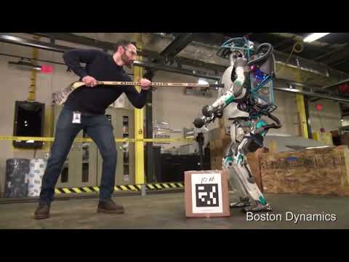
(Activator)
Notes:
This video is an exciting look at autonomous robot.
Questions to ponder:
What was interesting about the robots?
What kinds of things are the robots doing?
Are these robots being remote controlled?
We will learn more about this today :)

Slide 4
EQs
How are autonomous robots different from other machines/software?
Where can we find autonomous robots working?
How can we differentiate between high, medium, and low levels of autonomy in robots?

Slide 5
Activity 1
Is it a robot or not?

Slide 6
What is a robot?
Rules of a robot:
It must be a machine (made by humans).
It must sense its environment.
It must be programmable (respond to instructions).
It is controlled from within or is remotely controlled.
It must perform a physical action.

Slide 7
What’s not a robot?
Software “bot” that automates a task but doesn’t control a physical device

Slide 8
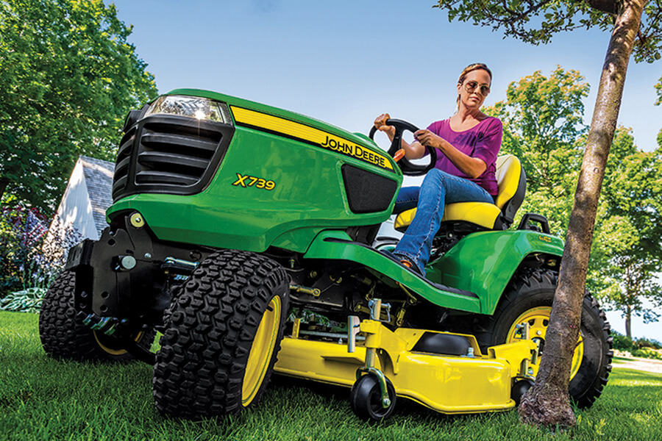
Example: Robot or Not? Riding Lawn Mower

Slide 9
Optional Resources
Kahoot Instructor Edition*
*Note that the Kahoot Instructor Edition does not have all of the same examples as the slides/worksheet and due to gray areas of robot, some answers may spark debate.

Slide 10
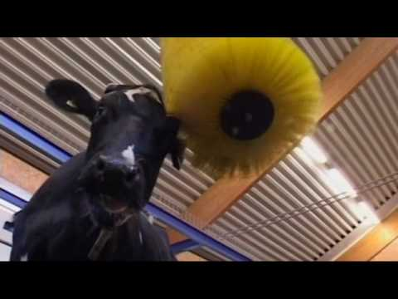
Robot or Not? Cowbrush

Slide 11
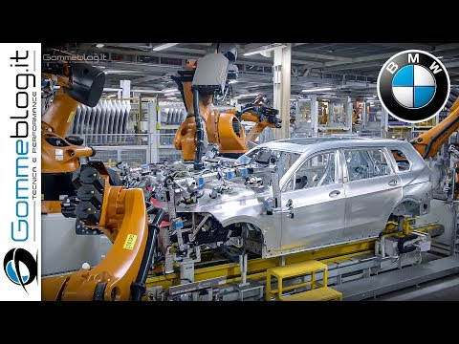
Robot or Not?
Car Assembler

Slide 12

Robot or Not? Netflix Recommendation Bot

Slide 13
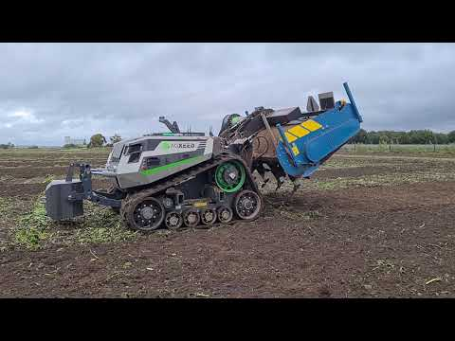
Robot or Not?
Self-Driving Tractor

Slide 14

Robot or Not?
TikTok

Slide 15
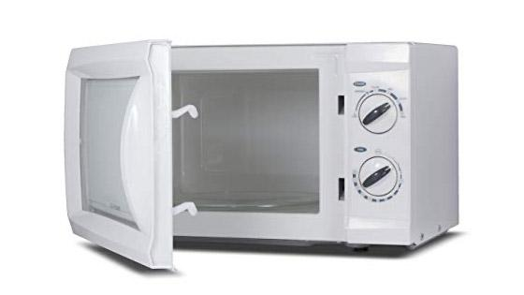
Robot or Not?
Microwave

Slide 16
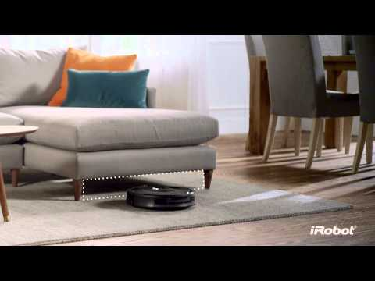
Robot or Not?
Roomba Vaccum

Slide 17
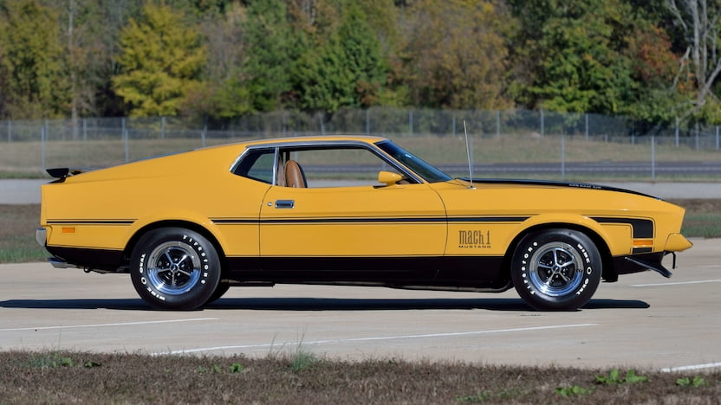
Robot or Not?
1970
Ford
Mustang Mach 1

Slide 18
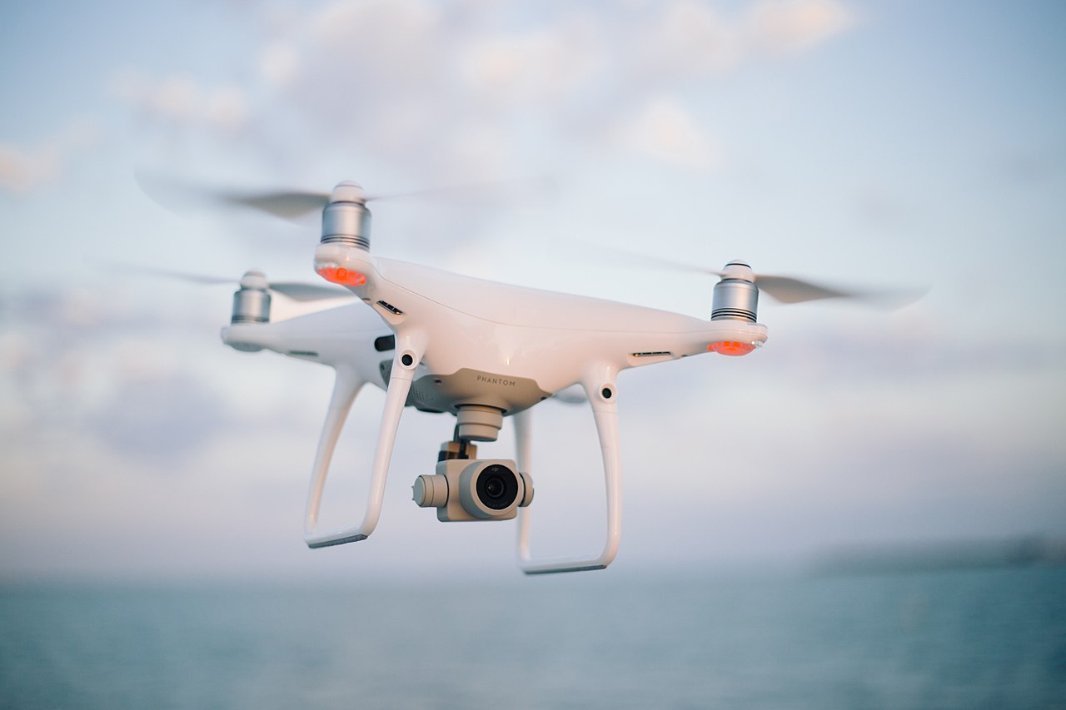
Robot or Not?
Drone

Slide 19

Robot or Not?
Tablet

Slide 20
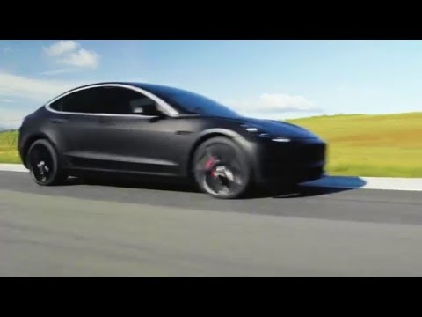
Robot or Not?
Self-Driving Car

Slide 21

Robot or Not? Toy

Slide 22
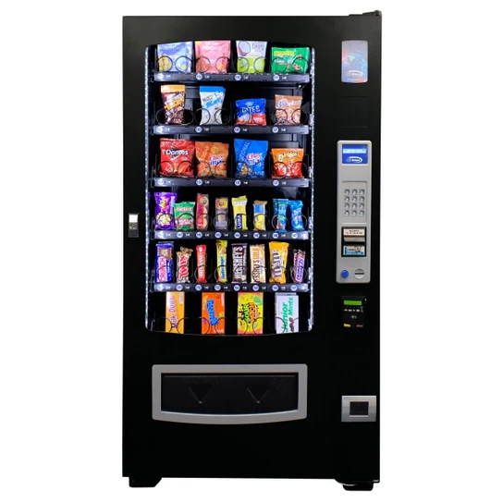
Robot or Not?
Vending Machine

Slide 23
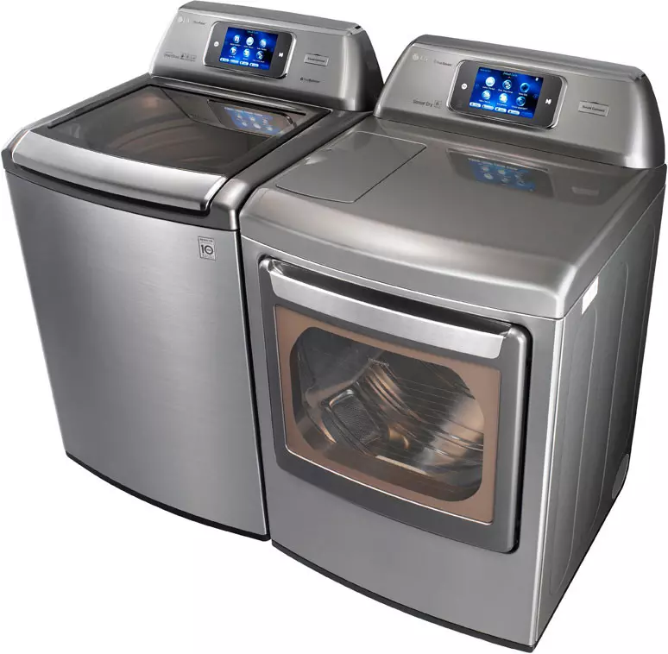
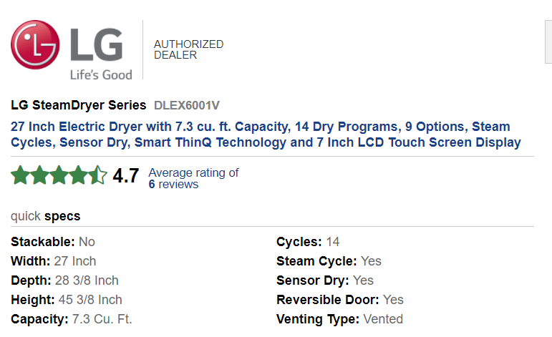
Robot or Not?
Washing Machine

Slide 24

Careers in Robotics
Robotics is an interdisciplinary field that draws ideas from electrical engineering, mechanical engineering, and computer science (including artificial intelligence).
Mechanical Engineer
Computer Scientist
Roboticist

Slide 25
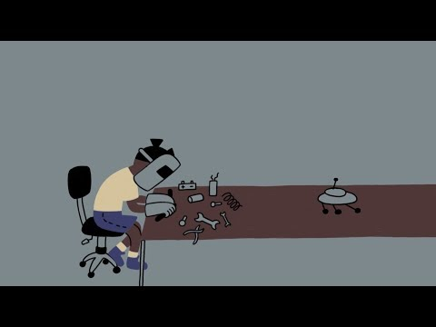

Dr. Ayanna Howard
Roboticist, NASA Engineer, Entrepreneur, Professor, & Dean
Learn more about her journey. Watch & Read, Deeper Read

